Slide 1









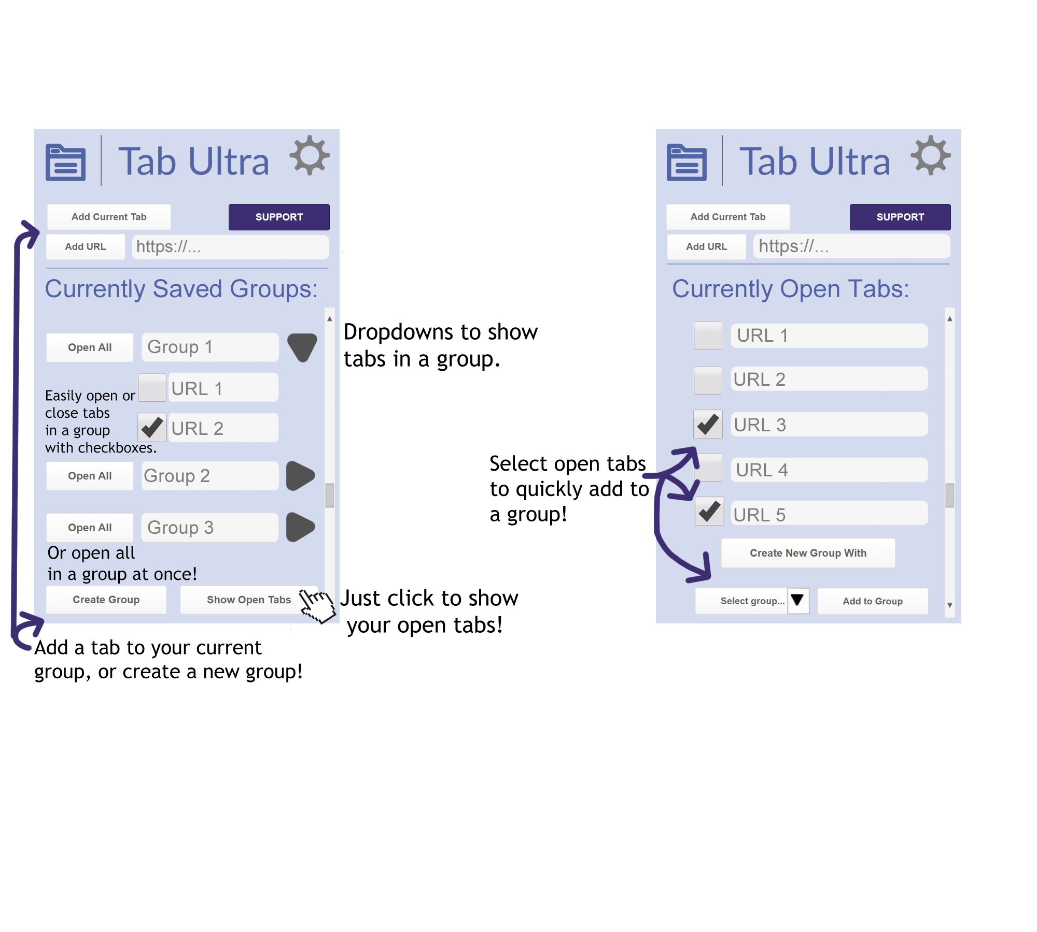
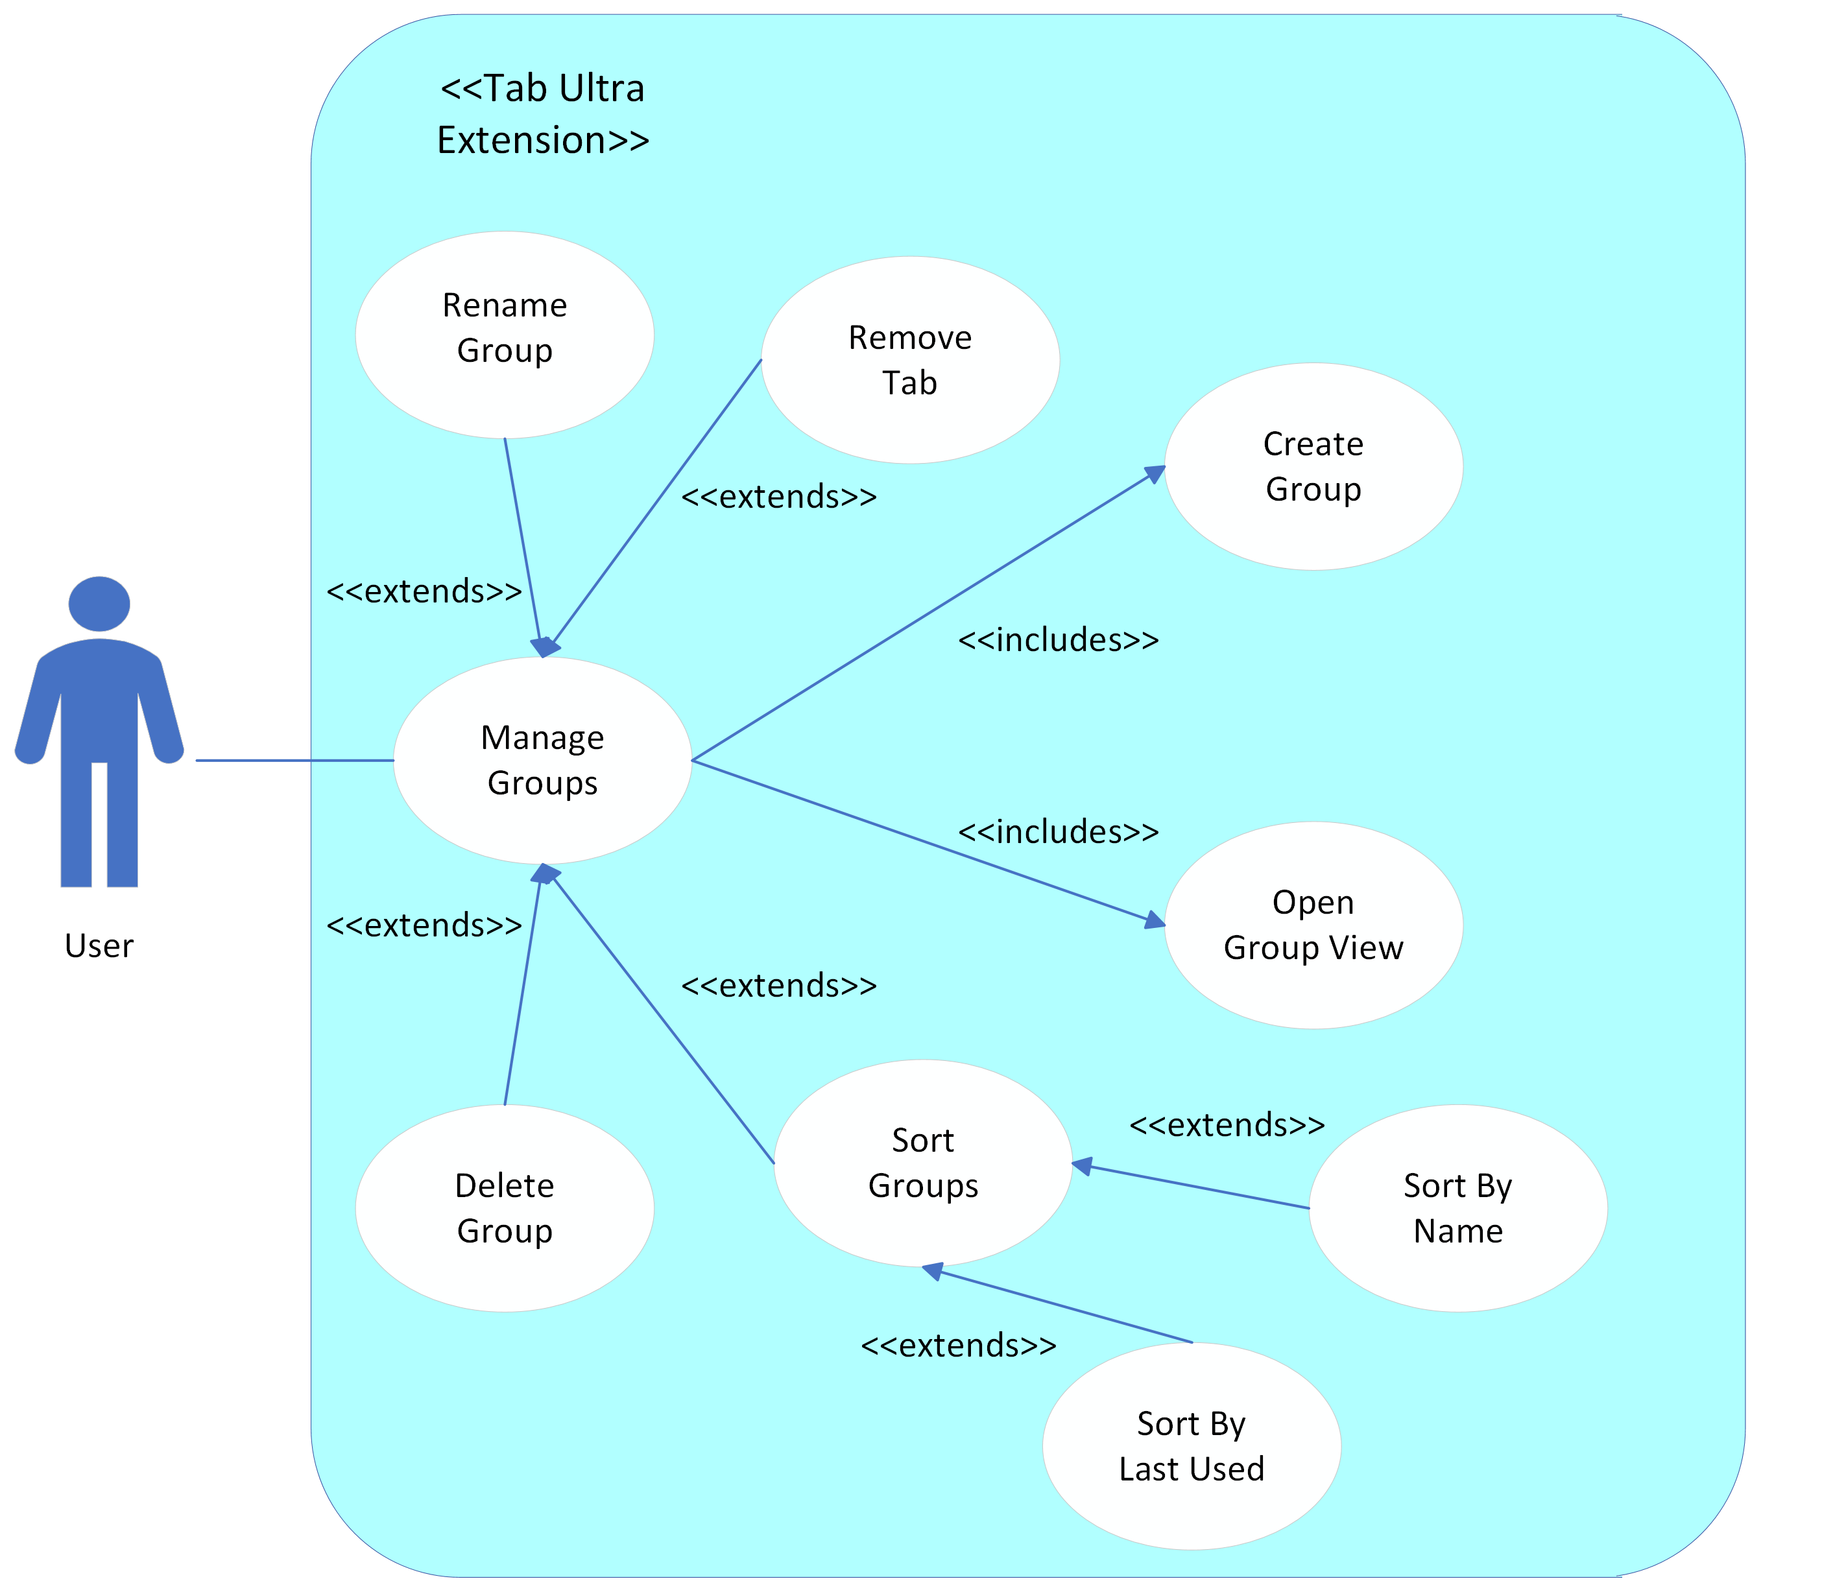
Tab Ultra
Vincent Bistricky, Kyle Butler, Dylan Brown, Christopher Begley, Adam Abdulhalim
University of North Florida, College Jacksonville, FL USA 32224
INTRODUCTION
DEVELOPMEN AND FUNCTIONALITY
DEVELOPMENT TOOLS
Whether it be in a work environment, personal research, or every-day life, many users find themselves having potentially tens of tabs open all at the same time. Keeping tabs organized and managed without having them constantly be opened, crowding your browser, and eating at your memory, is what Tab Ultra is being developed for. Tab Ultra is a Google Chrome-based browser extension that allows users to save, group, and manage tabs for specific use-cases so that any and all tabs can be quickly re-opened for user convenience.
Tab Ultra makes heavy use of JavaScript and CSS for back-end implementation and relies on HTML for displaying all front-end GUI elements. What makes the saving of tabs and groups across multiple Google Chrome instances is Chrome’s Storage API. This allows for data to be stored locally and then synced across any Chrome browser that the user is logged in to across any
device. Tab Ultra features a tab view and a group view. The tab view allows tabs to be selected from open tabs or added manually and saved into either a new group or an existing group. The group view displays all saved groups, allows the user to select and open any or all tabs in each group, and view group metadata (date created, last used, etc.).
Popup functionality
Extension design
LEARNING TOOLS
Extension and web development API
CSS and HTML tutorials
JavaScript and coding support
DEMONSTRATION
OBJECTIVES
Does your browser look like this? You need: Clean and easy to use!
The goal of Tab Ultra is to maximize convenience and ease-of-use when it comes to managing tabs. Tab Ultra will allow a user to select and store any opened tabs into a group which they can then name, save, and manage in multiple different ways. Each group can then be accessed, and user-selected tabs can be re-opened instead of having to manually open each potential bookmark the user may have created. Unlike similar extensions, Tab Ultra aims to be as non-intrusive as possible by having all functionality be confined to a pop-up window within the currently open tab. The act of being taken to a separate page to manage groups and tabs is what Tab Ultra intends to avoid.
USE CASES

